Slide 1

CLASS Simulations Vertical Subsidence Velocity
Atmospheric Simulations
Nadia Kairaktidi
1068622

Slide 3
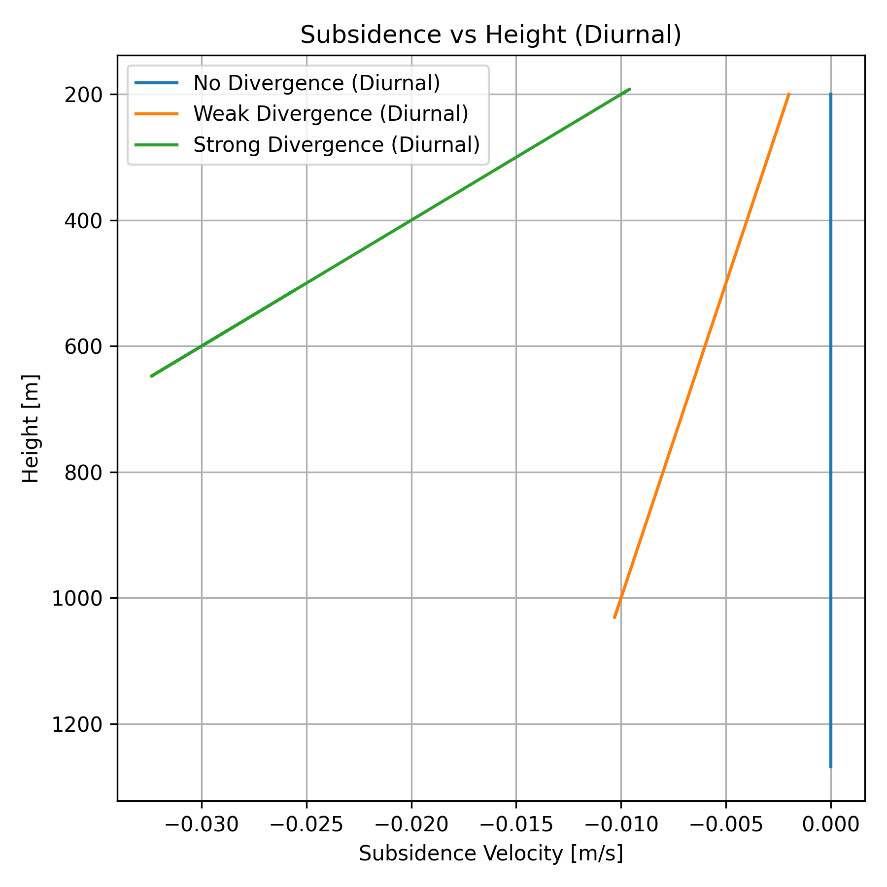
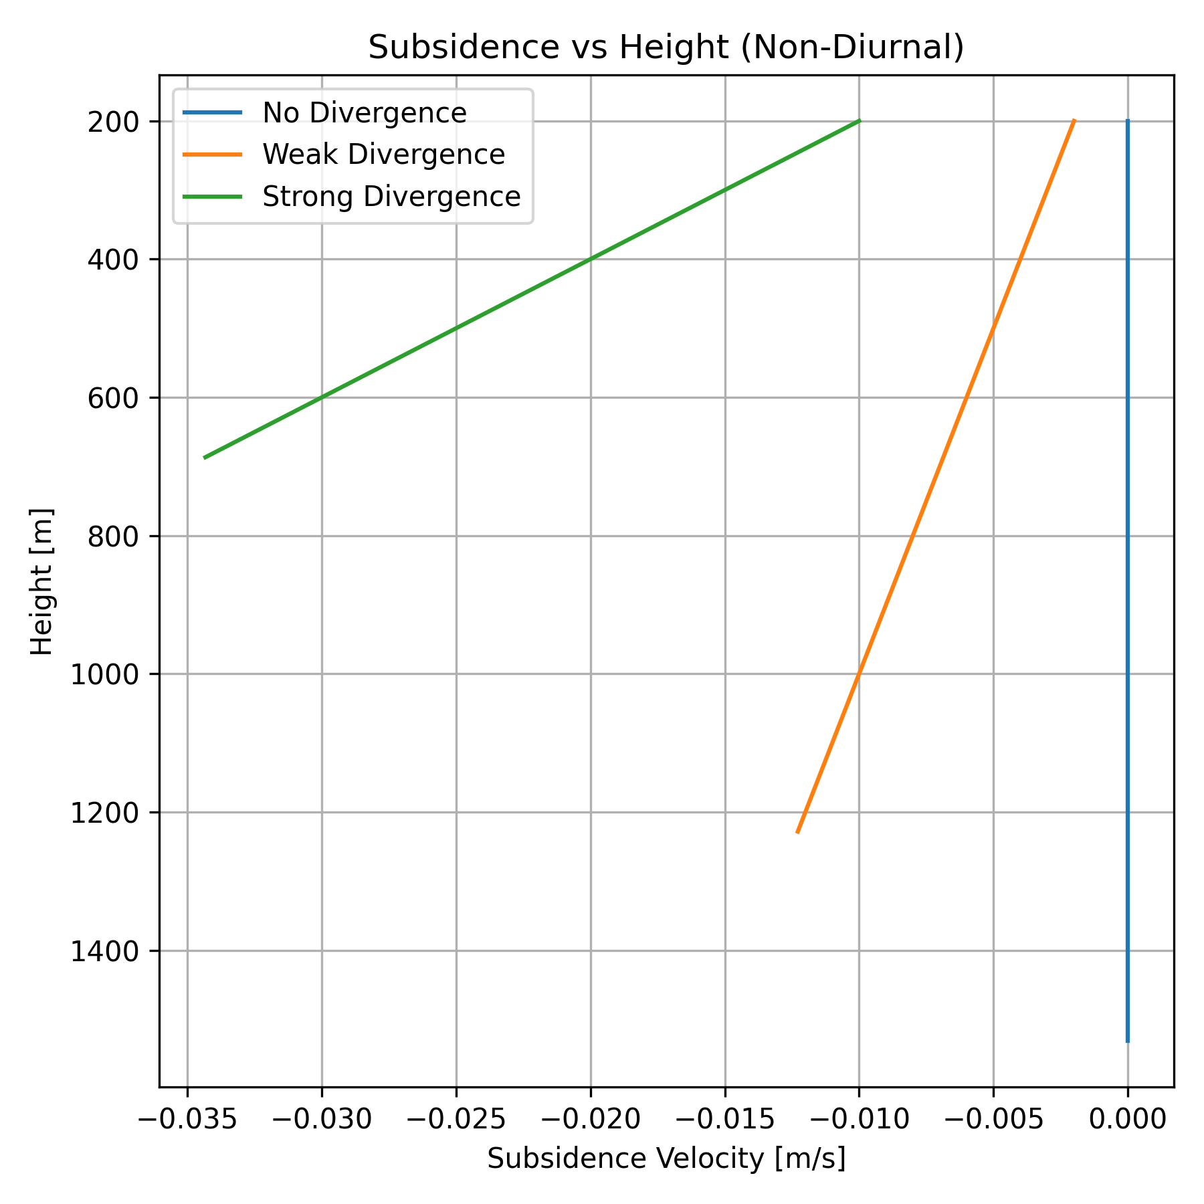

Slide 5



Slide 7
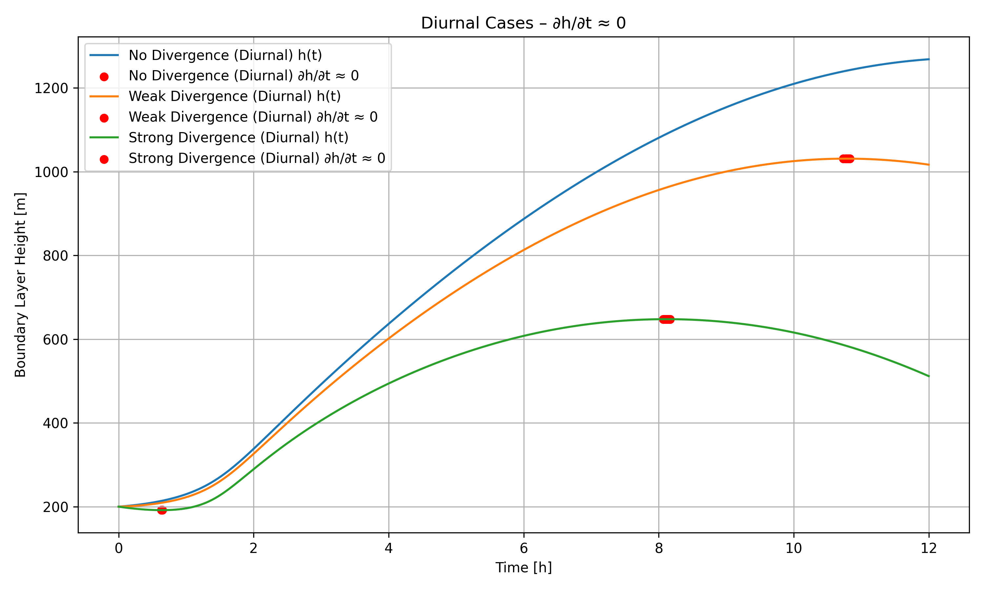

Slide 8
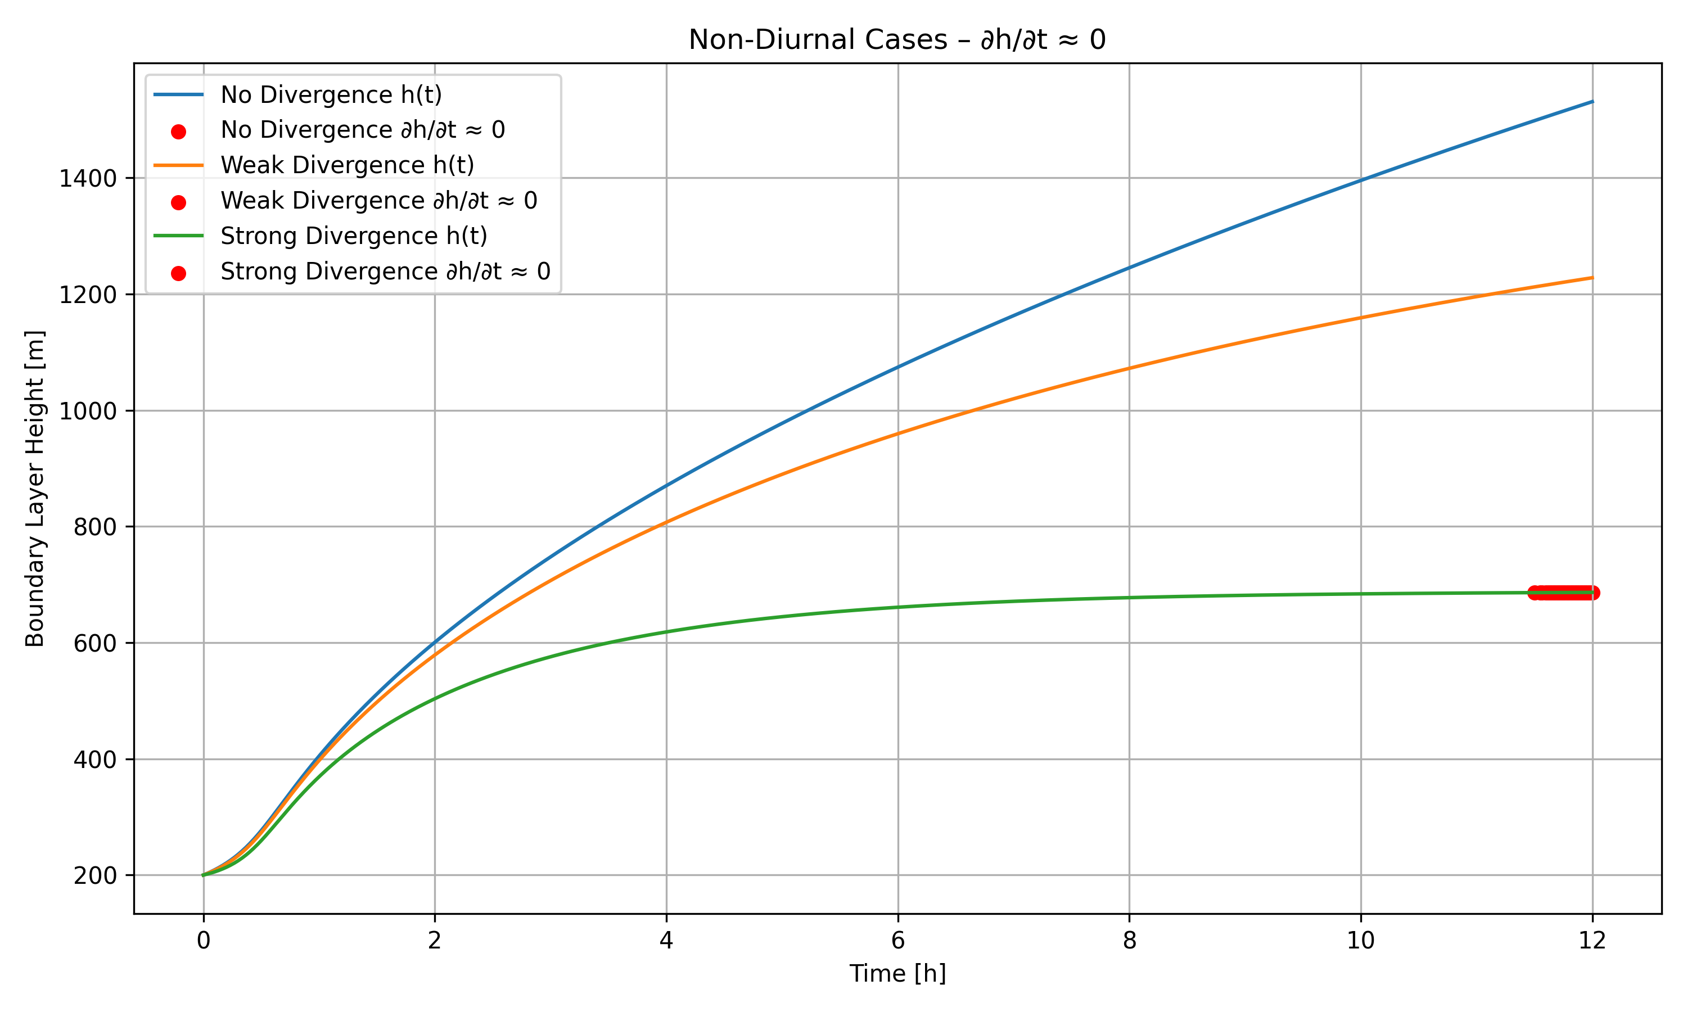

Slide 10


